Slide 1
DAA Macro Project
Design and Analysis of Algorithms
Five units • Five algorithms • Five visualizations
Group 3 | B.Tech CSE | Growth Analysis · Greedy · Dynamic Programming · Backtracking · Branch and Bound

Slide 2
Project Overview
One project per unit
Unit | Project | Topic | Technique
Unit I | Project 3 | Asymptotic Growth Comparison | Asymptotic analysis
Unit II | Project 6 | Optimal Merge Pattern Tree | Greedy
Unit III | Project 9 | Knapsack DP Table | Dynamic programming
Unit IV | Project 12 | Graph Coloring Backtracking | Backtracking
Unit V | Project 13 | Knapsack Branch and Bound | Branch and bound
Each project includes: AI visualization prompt • generated visualization • pseudocode • verified result

Slide 3
UNIT I – Asymptotic Growth Comparison
Project 3
Problem
Pseudocode
Compare Big-O, Omega and Theta notations and the growth of common functions, using example algorithms.
ALGORITHM CompareGrowth(algorithms)
for each algorithm A:
O ← worst-case bound of A
Ω ← best-case bound of A
if O and Ω have the same order:
Θ ← that order (tight bound)
for n ← 1 to 20:
plot 1, log n, n, n log n, n², 2ⁿ
rank the functions by growth rate
Key idea
O: upper bound, f(n) ≤ c·g(n) (worst case)
Ω: lower bound, f(n) ≥ c·g(n) (best case)
Θ: tight bound = O and Ω together
Linear search O(n), Ω(1); insertion sort O(n²), Ω(n); merge sort Θ(n log n)
Result: Growth order: 1 < log n < n < n log n < n² < 2ⁿ | at n = 20: n² = 400 vs 2ⁿ = 1,048,576

Slide 4
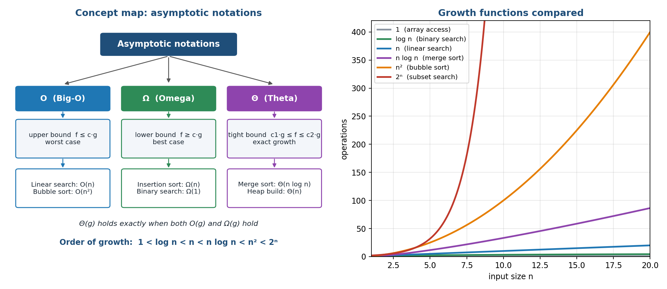
UNIT I – Visualization
Asymptotic Growth Comparison
What to notice
Left: concept map linking O, Ω, Θ to example algorithms
Right: six growth curves on the same axes
2ⁿ leaves every polynomial far behind by n = 20
Θ(g) needs both O(g) and Ω(g)

Slide 5
UNIT II – Optimal Merge Pattern Tree
Project 6
Problem
Pseudocode
Merge files of sizes 10, 20, 30, 40 into one file with the minimum total merge cost.
ALGORITHM OptimalMerge(sizes[1..n])
H ← min-heap of sizes
cost ← 0
while |H| > 1:
a ← EXTRACT-MIN(H)
b ← EXTRACT-MIN(H)
INSERT(H, a + b)
cost ← cost + a + b
return cost
Key idea
Greedy rule: always merge the two smallest files
Each merge creates an internal node of a binary tree
Cost of a merge = size of the merged file
Same idea as Huffman coding; ties give equal cost
Result: Merges: 10+20 = 30, 30+30 = 60, 40+60 = 100 | Total cost = 30 + 60 + 100 = 190

Slide 6
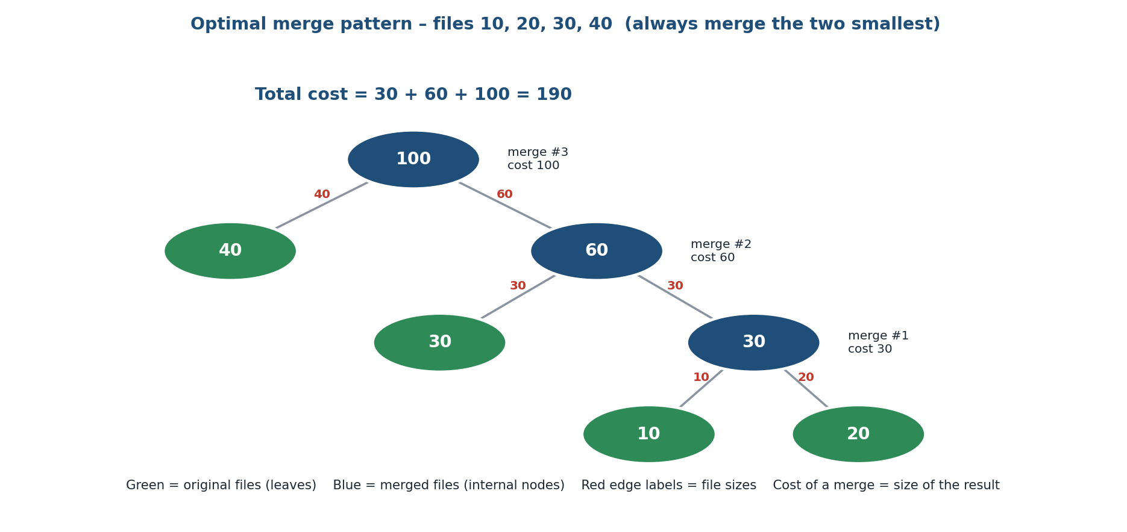
UNIT II – Visualization
Optimal Merge Pattern Tree
What to notice
Green leaves = original files
Blue nodes = merged files, built bottom-up
Root 100 = final file
Small files sit deepest, so they are re-merged most often

Slide 7
UNIT III – Knapsack DP Table
Project 9
Problem
Pseudocode
0/1 Knapsack: 4 items, weights [5, 4, 6, 3], values [10, 40, 30, 50], capacity 10.
ALGORITHM Knapsack01(w[], v[], n, W)
for c ← 0 to W: dp[0][c] ← 0
for i ← 1 to n:
for c ← 0 to W:
dp[i][c] ← dp[i−1][c]
if w[i] ≤ c:
take ← v[i] + dp[i−1][c − w[i]]
dp[i][c] ← max(dp[i][c], take)
c ← W
for i ← n down to 1:
if dp[i][c] ≠ dp[i−1][c]:
take item i; c ← c − w[i]
return dp[n][W]
Key idea
State dp[i][c]: best value using first i items, capacity c
Choice: skip item i, or take it and use w[i] capacity
Item i is included exactly when dp[i][c] ≠ dp[i-1][c]
Table has (n+1) × (W+1) cells
Result: Maximum value = 90 | Items 2 and 4 chosen (weight 4 + 3 = 7 ≤ 10)

Slide 8
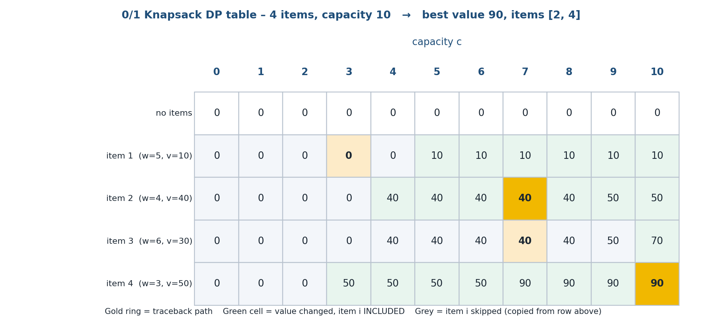
UNIT III – Visualization
Knapsack DP Table
What to notice
Each cell = best value for that item set and capacity
Green cells: the value changed, so the item was included
Gold cells: traceback path from dp[4][10]
dp[4][10] = 90 is the answer

Slide 9
UNIT IV – Graph Coloring Backtracking
Project 12
Problem
Pseudocode
Colour a 4-vertex graph (edges 1-2, 1-3, 2-3, 2-4, 3-4) with 3 colours so that no edge joins equal colours.
ALGORITHM GraphColoring(k)
for each colour c in {R, G, B}:
if IS-SAFE(k, c):
color[k] ← c
if k = n: record solution
else: GraphColoring(k + 1)
color[k] ← none (undo)
return (backtrack)
IS-SAFE(k, c)
for each neighbour u of k:
if color[u] = c: return false
return true
Key idea
Colour vertices one at a time in order
Safe = no adjacent vertex already uses that colour
Conflict → try the next colour (prune that branch)
All 3 colours fail → backtrack and change the earlier vertex
Result: 2 solutions with v1 = R: R-G-B-R and R-B-G-R | 15 colour tries, 9 pruned (vs 3⁴ = 81)

Slide 10
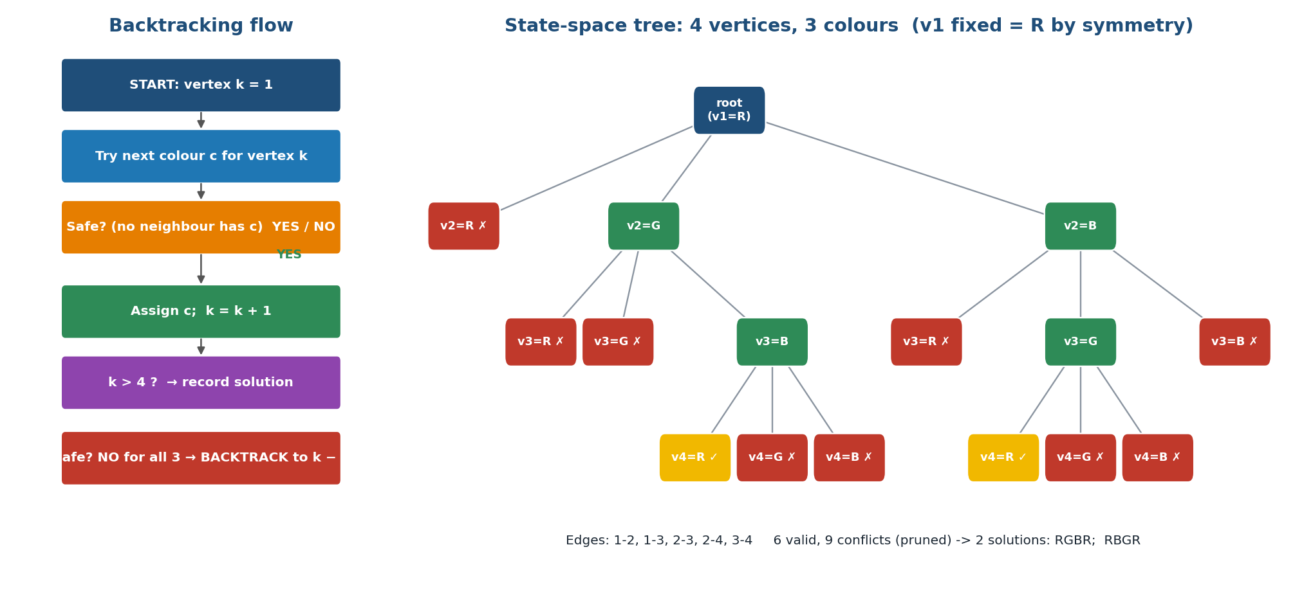
UNIT IV – Visualization
Graph Coloring Backtracking
What to notice
Left: the flowchart of the algorithm
Right: state-space tree, red ✗ = conflict
Dead end at v3 = R / G forces a change
Yellow ✓ = complete valid colouring

Slide 11
UNIT V – Knapsack Branch and Bound
Project 13
Problem
Pseudocode
0/1 Knapsack by Branch and Bound. Weights [4, 7, 5, 3], values [40, 42, 25, 12], capacity 10.
ALGORITHM KnapsackBB(w[], v[], n, W)
best ← 0
EXPLORE(root)
EXPLORE(u)
for choice in {include, exclude}:
child ← next-level node (weight, value)
if child.weight > W: prune
else:
ub ← BOUND(child)
if ub ≤ best: prune
else:
best ← max(best, child.value)
EXPLORE(child)
BOUND(node) = value + fractional fill
Key idea
Node = (level, weight, value, upper bound)
Bound = fractional-knapsack fill of the remaining capacity
Branch: include or exclude the next item
Prune if weight > W or upper bound ≤ best value found
Result: Optimal value = 65 (items 1 and 3, weight 9) | 9 of 31 nodes visited, 5 pruned

Slide 12
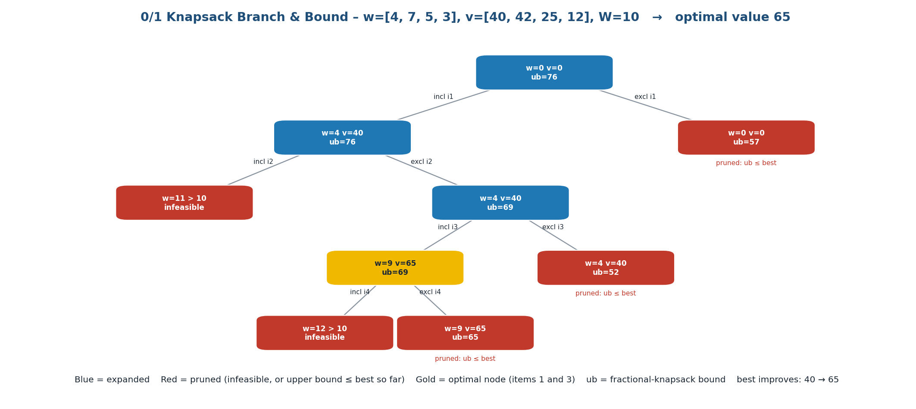
UNIT V – Visualization
Knapsack Branch and Bound
What to notice
Red = pruned (infeasible or ub ≤ best)
Blue = expanded node
Gold = optimal node, value 65
best improves 40 → 65, then bounds cut the rest

Slide 13
Complexity Comparison
All five projects
Project | Technique | Time complexity | Space | Verified result
3 Growth | Analysis | Growth rates compared | — | Order 1 < log n < n < n log n < n² < 2ⁿ
6 Merge Pattern | Greedy | O(n log n) | O(n) | Total cost 190
9 Knapsack DP | Dynamic programming | O(n·W) | O(n·W) | Value 90, items 2 and 4
12 Graph Coloring | Backtracking | O(m^n · n) worst case | O(n) | 2 colourings (v1 fixed), 9 pruned
13 Knapsack B&B | Branch & bound | O(2ⁿ) worst, pruned in practice | O(2ⁿ) | Value 65, 5 pruned
Greedy and DP avoid blind search; backtracking and branch and bound prune an exponential search tree; asymptotic notation lets us compare all of them on one scale.

Slide 14
Learning Outcomes
What we achieved
Unit I
Compare algorithms with O, Ω and Θ and rank growth rates
Unit II
Build a greedy solution (merge tree) and justify the always-merge-smallest rule
Unit III
Define DP states and transitions, fill a table and trace back the chosen items
Unit IV
Use backtracking with constraint checks, and prune dead branches
Unit V
Apply bounding functions to prune a branch-and-bound tree

Slide 15
Conclusion
One representative algorithm per DAA unit, implemented, run and verified
Every visualization matches its code output (190, 90, 2 solutions, 65)
Repository: pseudocode, AI prompts, visualizations and READMEs for each project
Thank You

